Slide 1

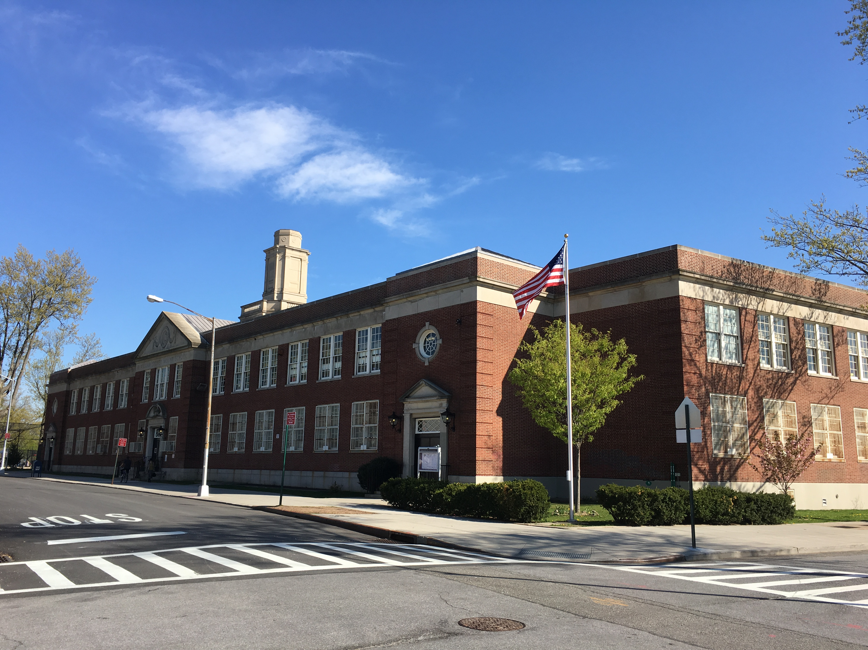
Public School 174
William Sidney Mount
Town Hall
Update on School Re-opening
Thursday, August 6, 2020
10am- 11am
Via MEET
Karin Kelly, Principal
Laura Hui, Parent Coordinator

Slide 2
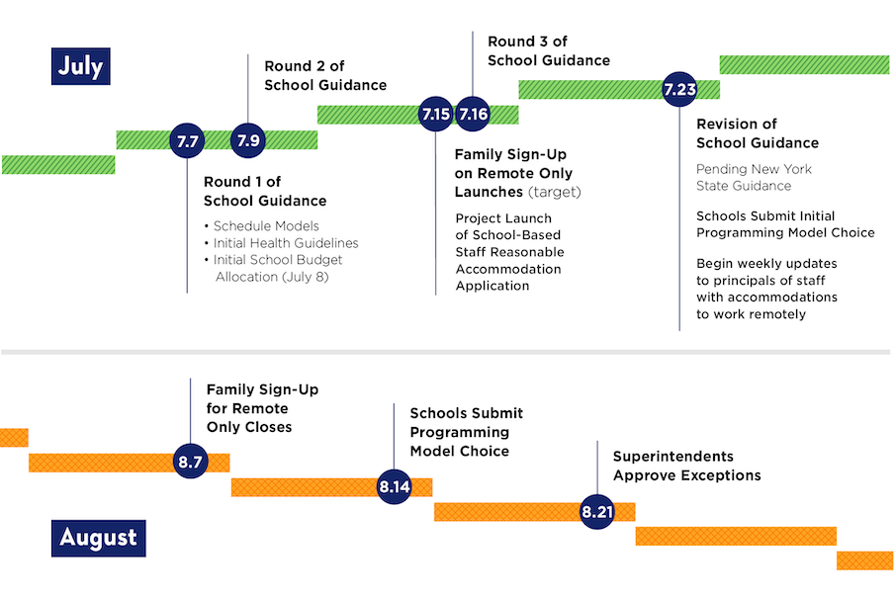
New York City Timeline

Slide 3


2020-2021 Learning Preference -
100% Remote Learning:
“Opt in” to have your child learn 100% remotely (all online from home) by August 7th.
https://www.nycenet.edu/surveys/learningpreference
To choose this option for your child, fill out and submit this form.
If you change your mind, please complete this form again before August 7th.
There will be scheduled cycles to opt back into blended learning.
If you have difficulties completing this form online, call 311.

Slide 4

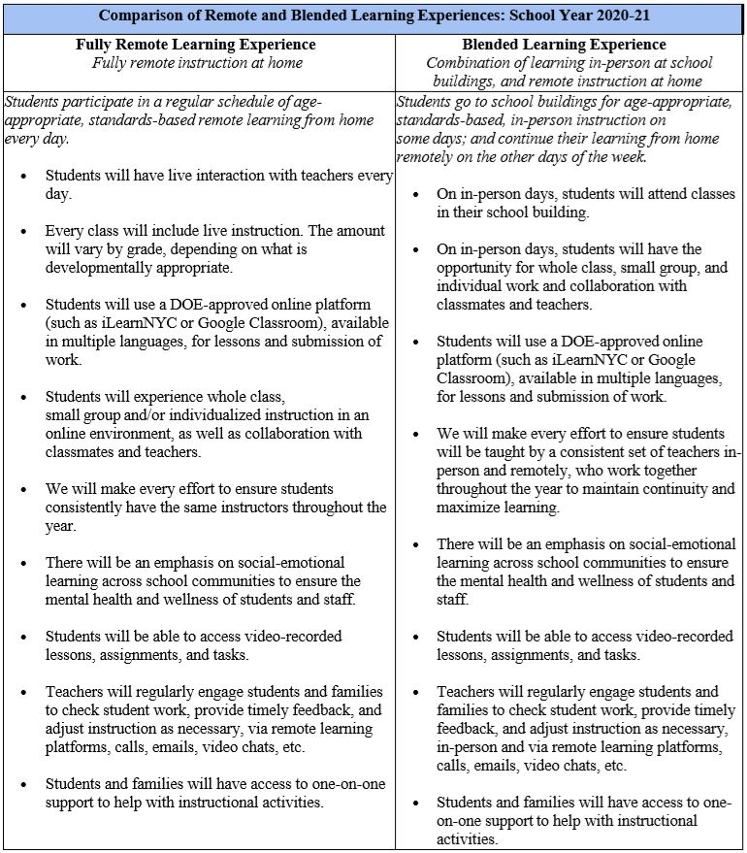
Opt into
100% Remote Learning online by August 7th.
Note:
Opt back into Blended Learning at scheduled intervals.TBD (ex November)
Blended Learning
Opt into—
100% Remote at Home anytime.

Slide 5
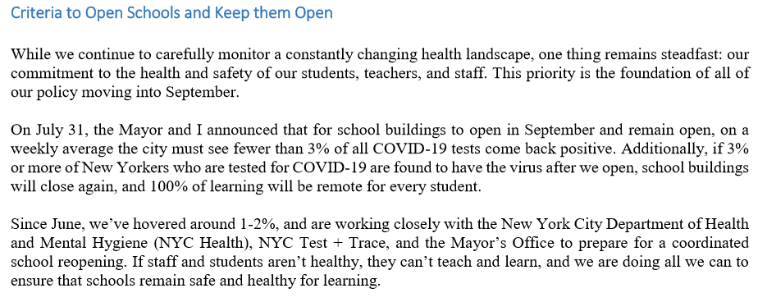
Chancellor Carranza’s Family Letter – August 3, 2020
Health and Safety Protocol

Slide 6
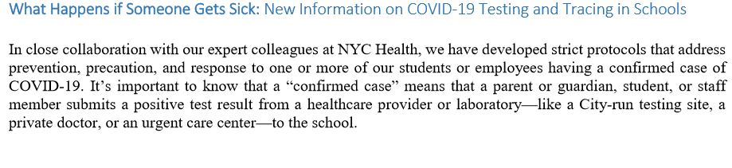
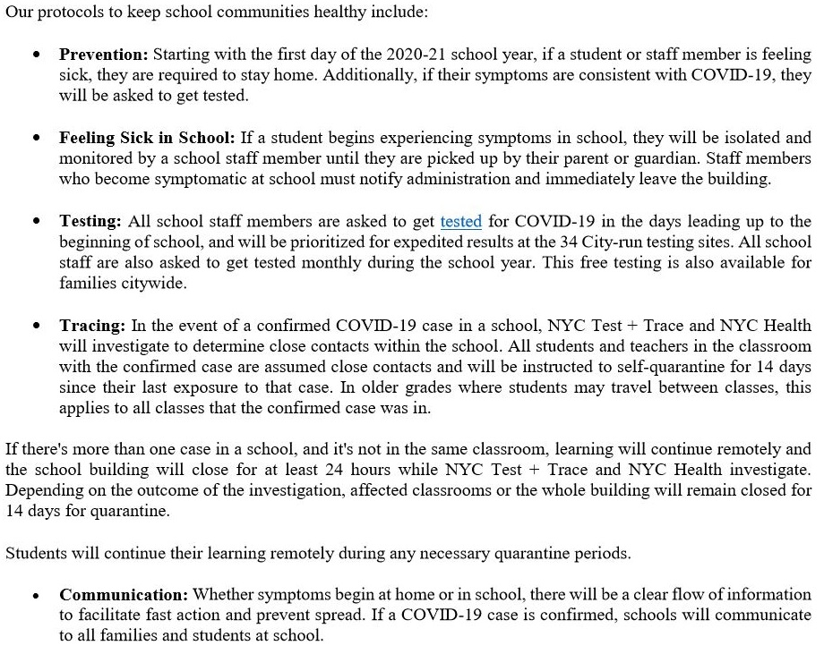

Slide 7
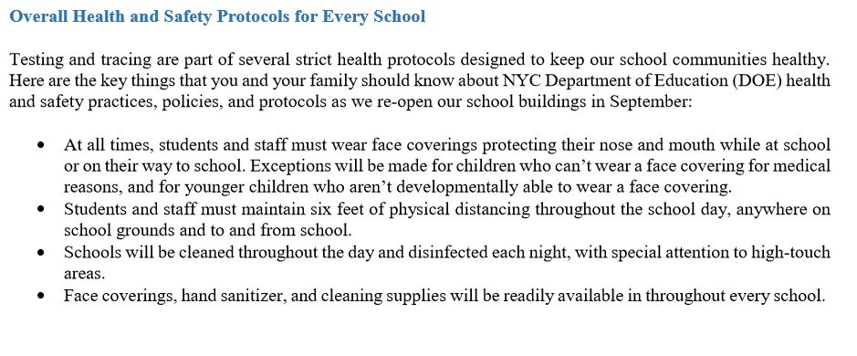
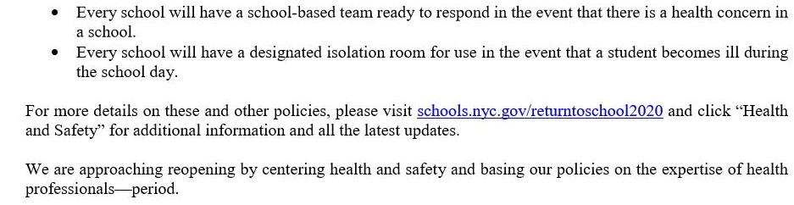

Slide 8
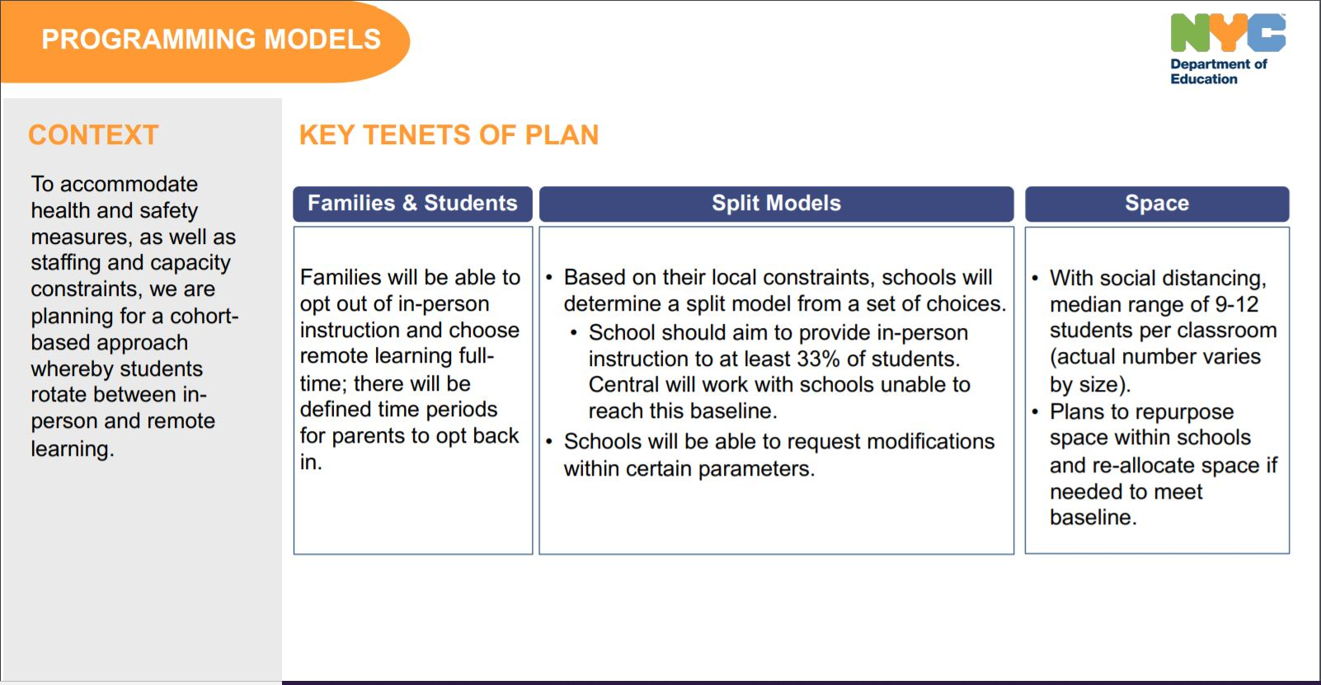

Slide 9
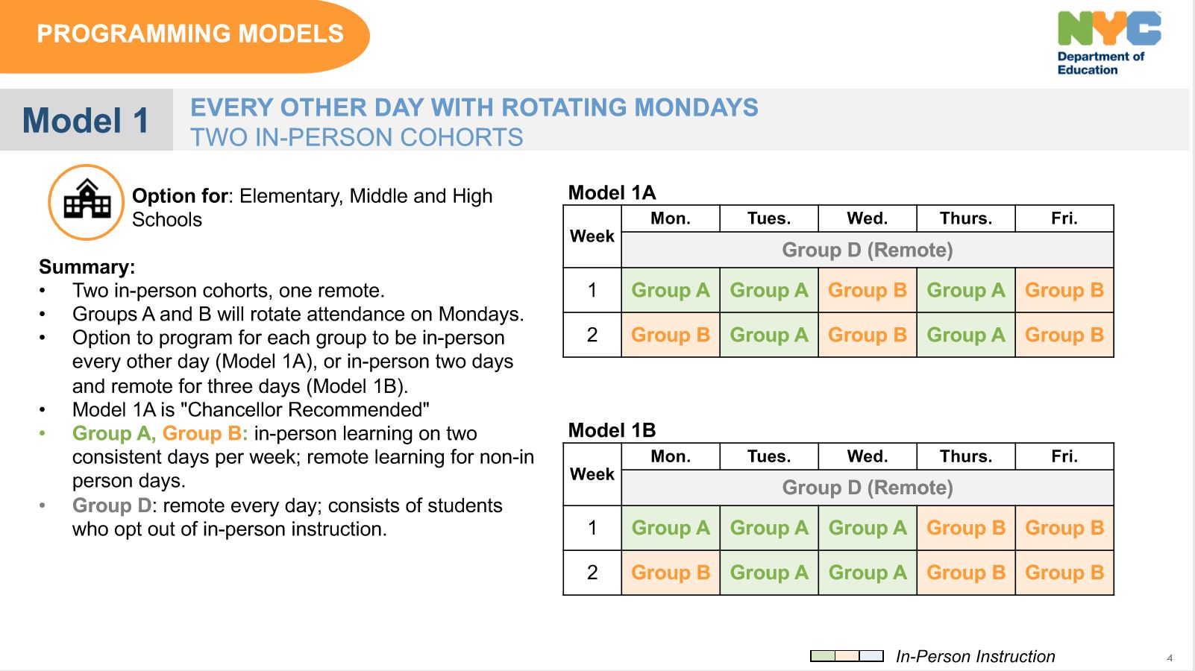

Slide 10
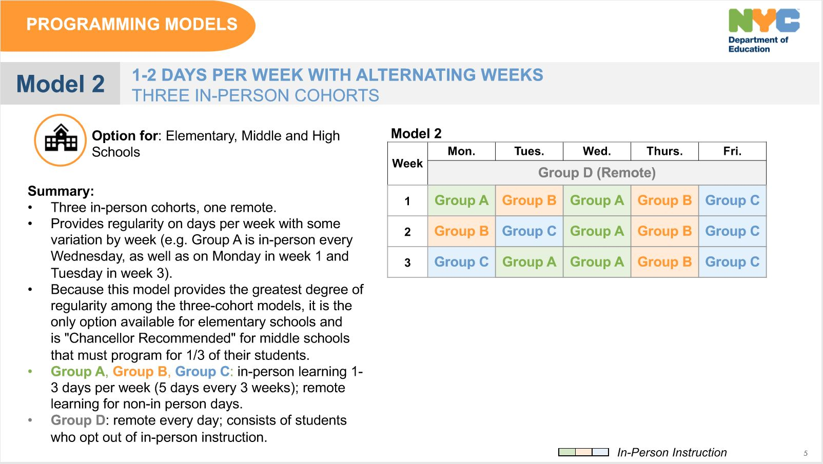

Slide 11
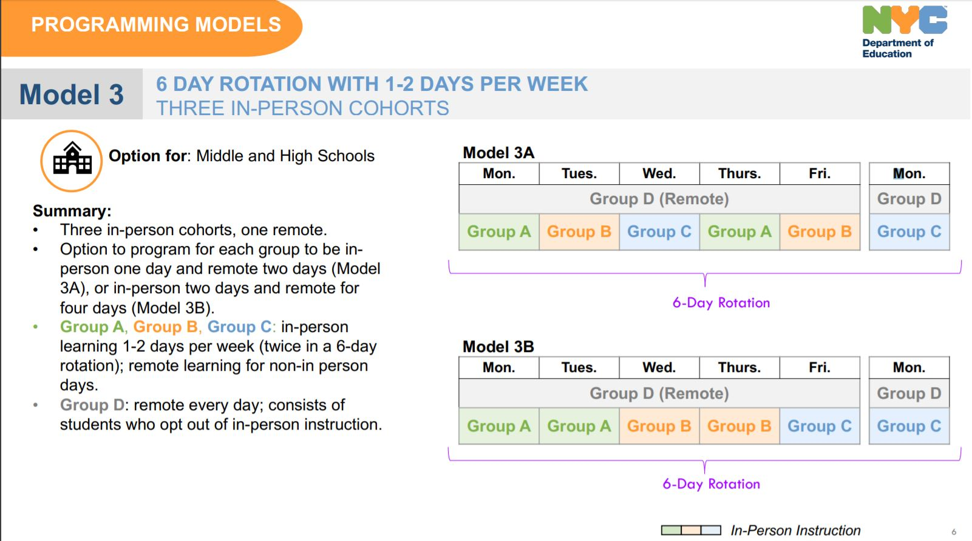

Slide 12
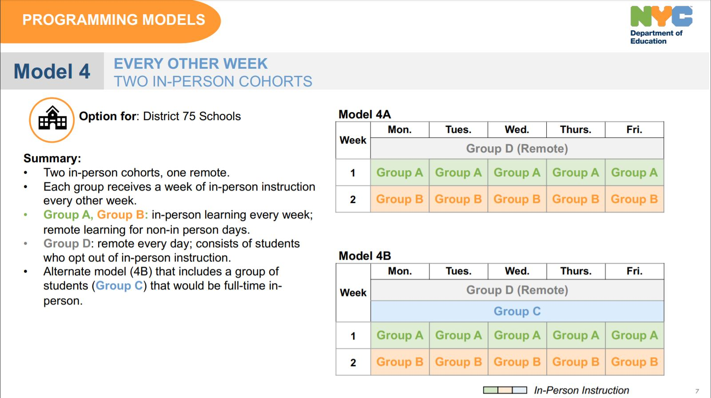

Slide 13
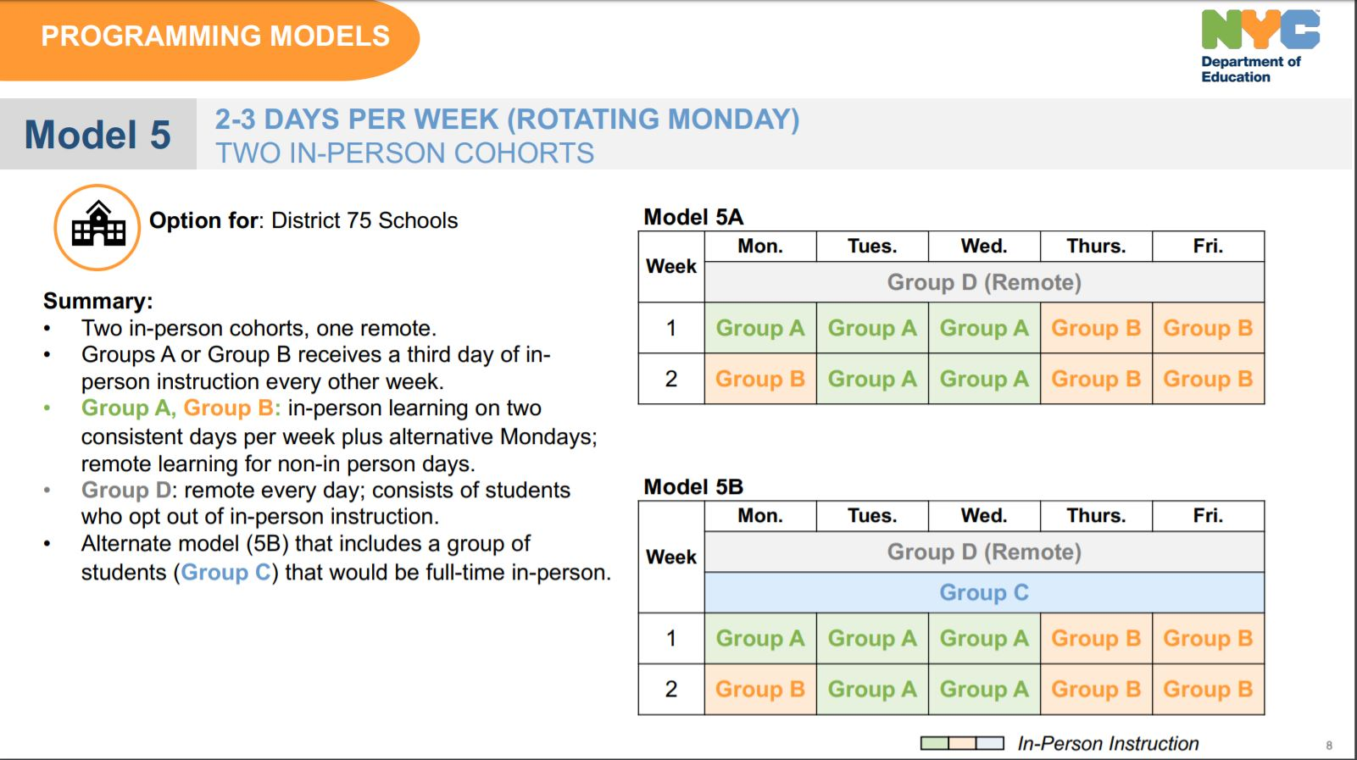

Slide 15

District 28 Early Planning Re-Opening Survey in July
PS 174
(374 survey responses)
Thank you to all who completed the Survey!
Are you planning to opt your child into full time remote learning in place of the blended model?
24% Yes 90
43% No 161
32% Undecided 123
Now tell us what concerns you the most about re-entry.
Rank the following.
Based upon your ranking above, tell us a little more about your number one concern.

Slide 16
Planning
Walkthrough Building Space
Staff and Student
? How many students opt for 100% Remote
? Staff who is working remote or in school
? # students per Class/ teacher assignments TBD
Safe and Health
Social Distancing
Masks
Daily Cleaning
Meals
Transportation
State Education Department Issues Guidance to Reopen New York State Schools | New York State Education Department The New York State Education Department released guidance to help schools and school districts as they plan to reopen, whether that occurs in person, remotely, or in a combination of the two. The guidance builds on the Framework of Guidance that the Department presented to the Board of Regents on Monday, July 13. “On Monday, the Department presented a comprehensive framework of ... www.nysed.gov Centers for Disease Control and Prevention Issued Re-opening Guidance CDC issued guidance on re-opening for school districts.

Slide 17

Save the date! Register!
NYC Citywide Virtual
Family and Student Return to School Sessions
With Chancellor Carranza
6:30pm- 8pm
Return to School 2020
Want to learn more about NYC schools plans for the 2020–21 school year?
Attend our virtual citywide Information session for students and families—
July 14, 2020
July 28, 2020
August 12, 2020
August 27, 2020
Register now: schools.nyc.gov/returntoschool2020. You can also select your preferred language (English, Spanish or Mandarin) and submit a question.

Slide 18
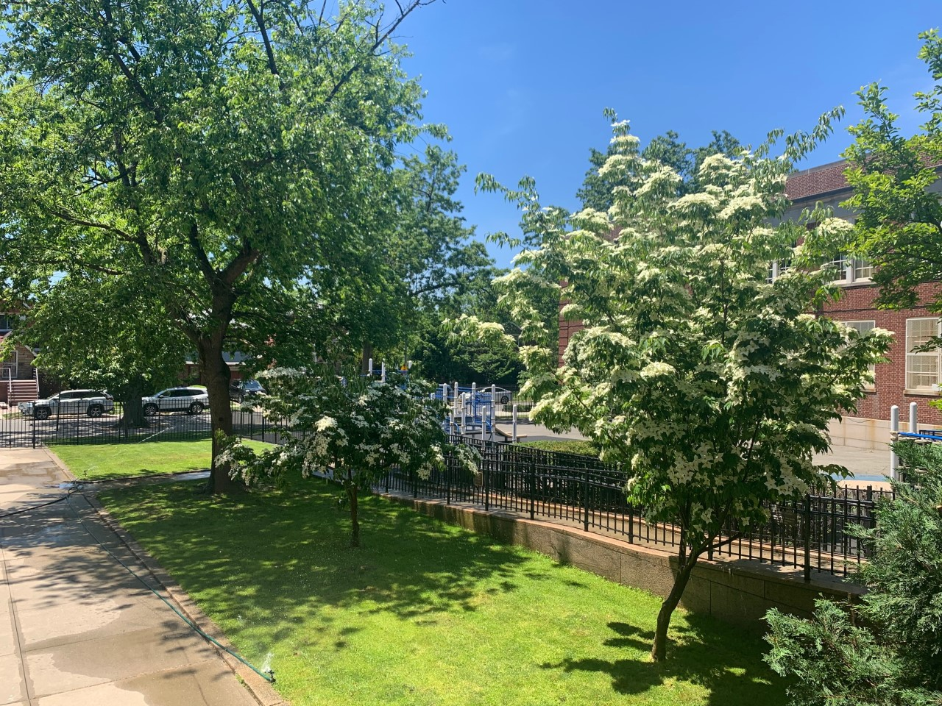
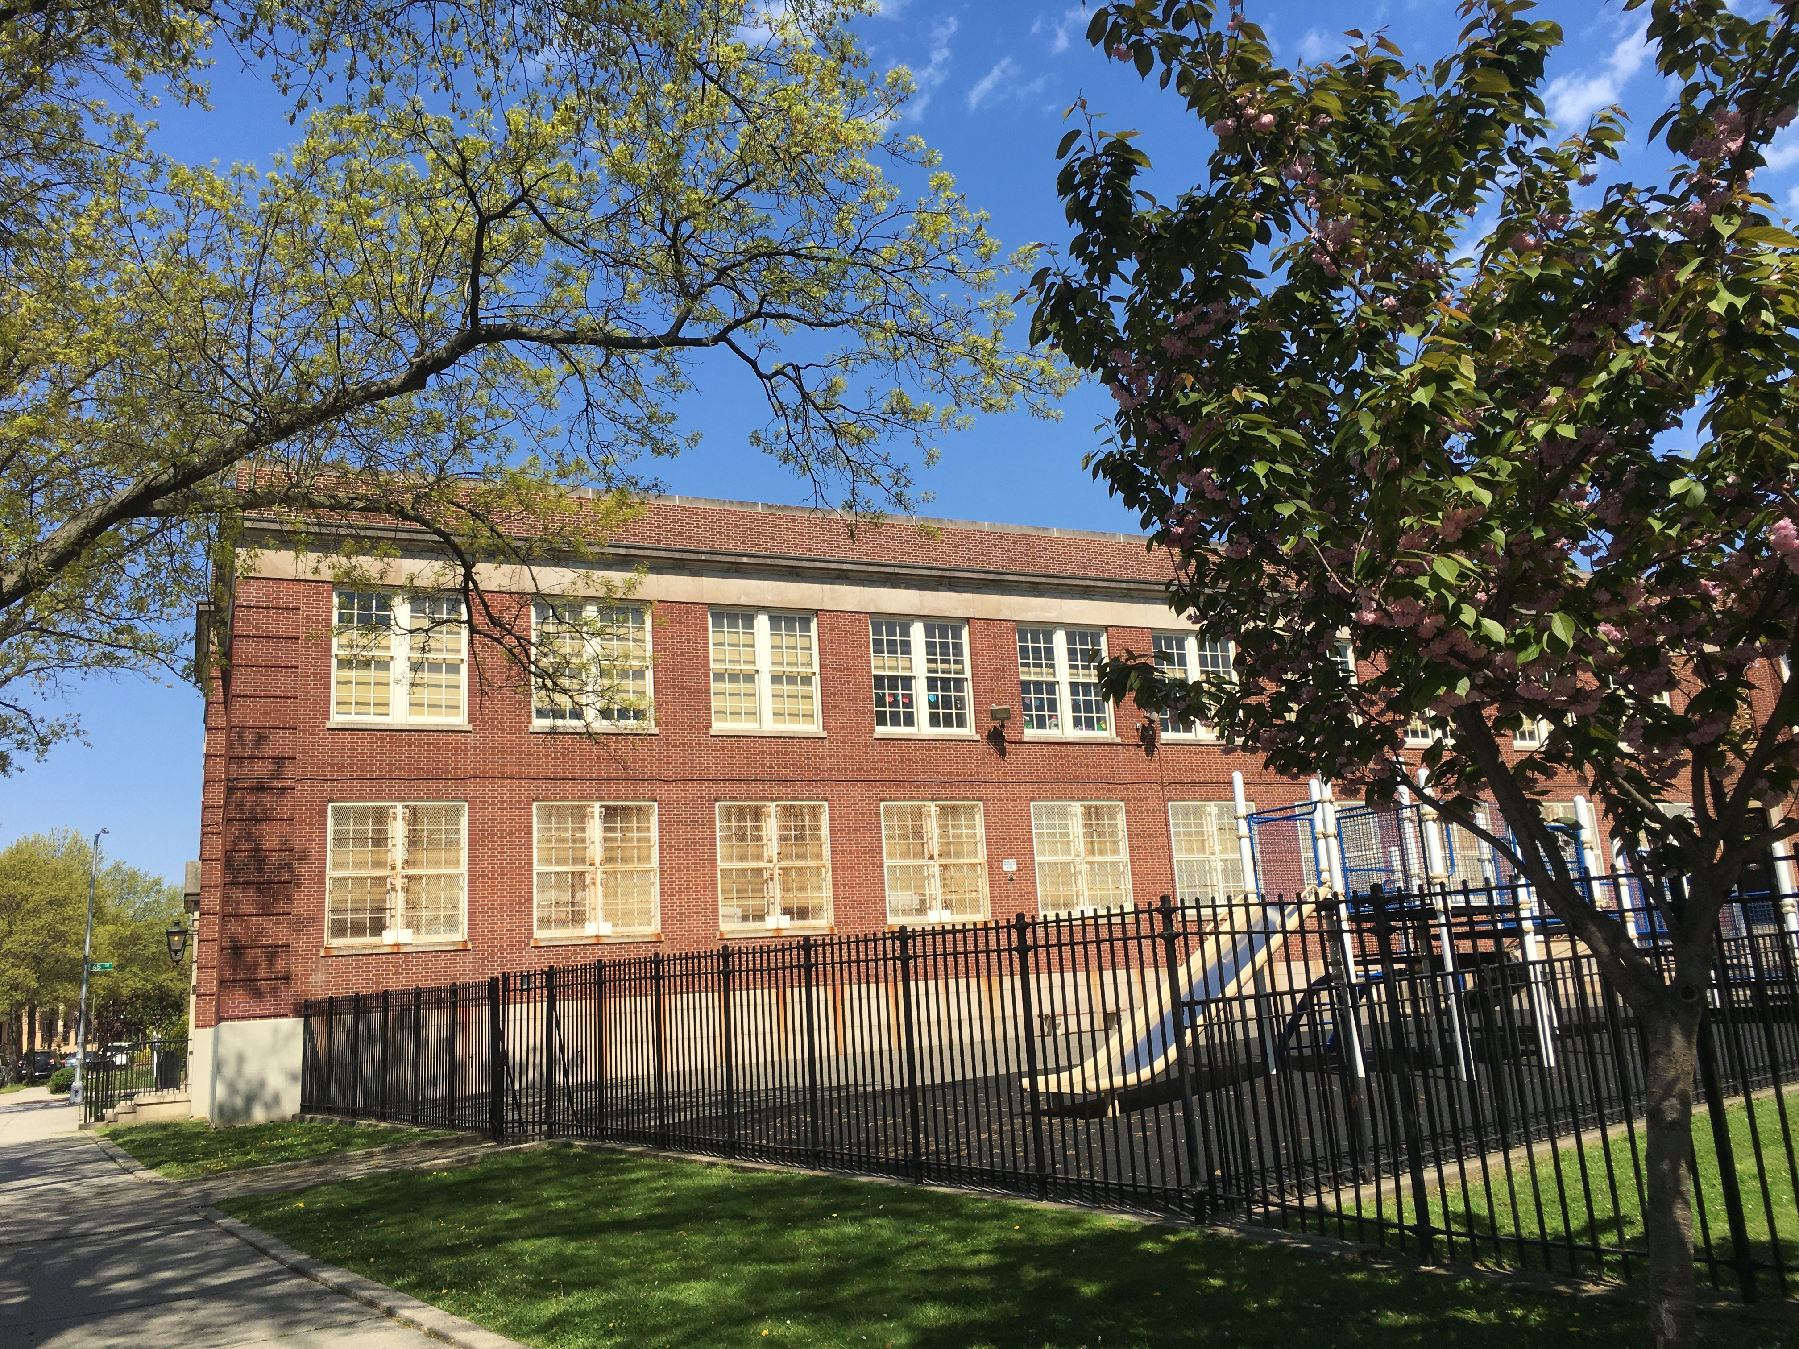
The Next Steps…
additional
“Updates on School Re-opening”
via email, Remind,
Town Hall and
Parent Information Sessions
Visit our websites---
ps174.org
schools.nyc.gov/ReturnToSchool

